Slide 1
Pathway to Revolution
IB Civics

Slide 2
Trouble in Paradise!
The colonies used to be happy under British rule, but in 1754…
The French & Indian War: England and France fought for domination of North America. This cost England a lot of money, so they made colonists pay high taxes to get that money back. The colonists had no say in the matter.
Proclamation of 1763:To make peace with France and their native allies, England said colonists could not move past the Appalachian mountains.

Slide 3
Acts
Salutary neglect: England didn’t enforce some laws because they didn’t want to upset the colonies.
1764 - The Sugar Act: England stopped salutary neglect and started enforcing a tax on foreign sugar, which was usually from French colonies. Because America wouldn’t buy their sugar, the French colonies wouldn’t buy American lumber. This hurt the economy.
1765 - The Stamp Act: England still needed money to pay for the French/Indian War. They put a tax on all official documents.
1766 - Declaratory Act: England is the only government that can make laws for the colonies. “I’m the boss!”

Slide 4
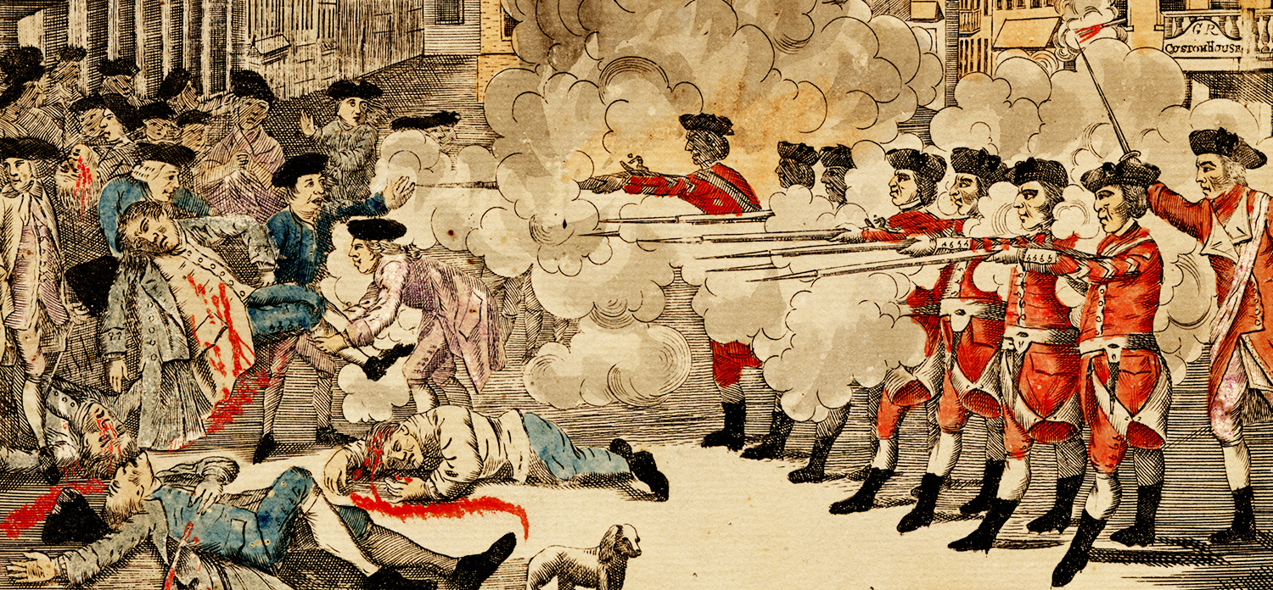
~Interlude: The Boston Massacre~
1770: A mob of colonists threw snowballs and rocks at British soldiers. The soldiers fired on the crowd, killing several colonists.
The soldiers were tried for murder but were acquitted. Two soldiers were later convicted of manslaughter.
This is seen as the event which directly led to the American Revolution. After the trial and ensuing tensions, the royal governor evacuated British troops from Boston.

Slide 5
Spilling Tea
1773 - Tea Act: The British East India Company hauled huge amounts of tea (more tax $) to the colonies and set cheap prices, which would hurt local businesses.
Colonists protested heavily and boycotted the tea, turning away ships or leaving the cargo to rot.
Boston Tea Party: Colonists disguised as Native Americans stormed cargo ships and threw 342 chests of tea into Boston Harbor.

Slide 6
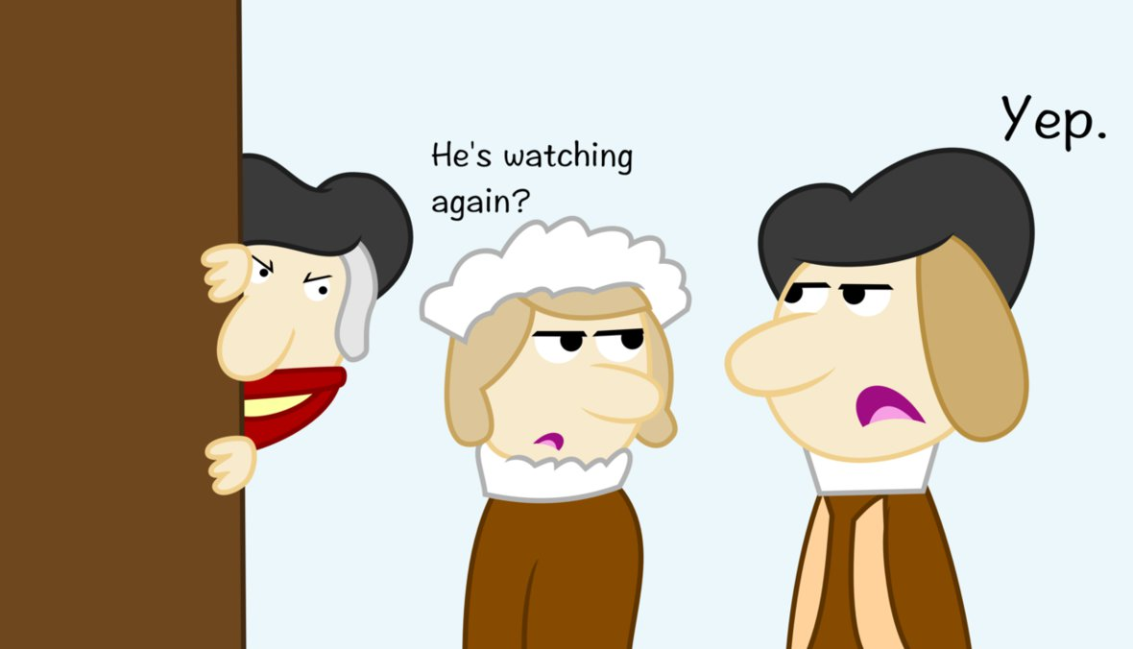
Response: The Intolerable Acts (1774)
Boston Port Act: No ships are allowed to enter or leave Boston Harbor
Massachusetts Government Act: England will appoint all leaders in MA
Quartering Act: England can station British soldiers in colonists’ homes
Administration of Justice Act: British officials charged with crimes can go to England for their trial

Slide 7
Colonies Respond:
In 1776, during the Revolutionary War, leaders from throughout the colonies met to draft a list of grievances to be included in the Declaration of Independence.

