Slide 1
Miranda vs. Arizona

Slide 2
Background
Ernesto Miranda’s case was about not being informed of his rights while being arrested for charges of kidnapping, rape and armed robbery charges. While he was being detained, he did not know that his confessions would be used against him in the court because he was not read his rights as he was facing 20-30 years in jail.

Slide 3
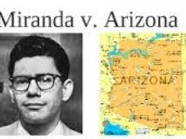
When did it happen?
Miranda vs. Arizona happened in 1966. It was argued on February 28, March 1 and March 2 and it was decided on June 13, 1966.

Slide 4
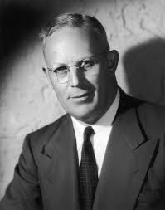
Who was the chief justice?
The chief justice during the MIranda vs Arizona case was Chief Justice Earl Warren

Slide 5
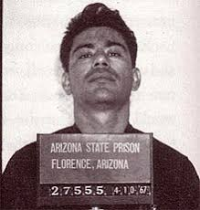
What was the case about? What happened?
The case of Miranda vs. Arizona was ruled by the Supreme Court that detained criminal suspects, prior to police questioning, must be informed of their constitutional right to an attorney and against self-incrimination. The case was about how Miranda was not informed of how his confession would be used in court since he was facing 20-30 years in jail.

Slide 6
What was the constitutional issue?
The constitution issue was how the 5th amendment “compelled in any criminal case to be a witness against himself” meaning that the 5th amendment was violated in the case of Miranda vs Arizona.

Slide 7
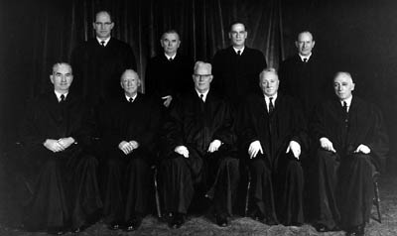
What was the vote?
The vote went 5-4 being written by Chief Justice Earl Warren that Miranda’s confession could not be used against him because he was failed to be informed of his rights.

Slide 8
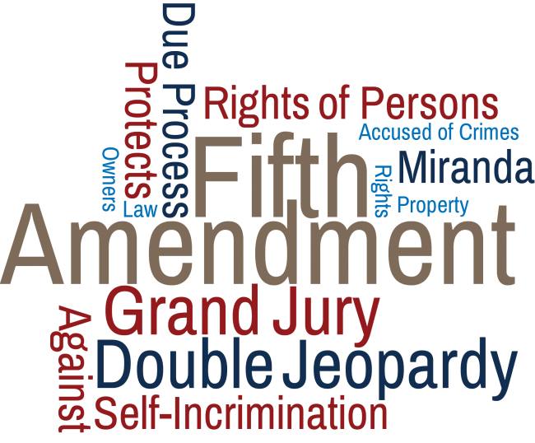
What effect did the case have on the U.S.
The effect that the case Miranda vs. Arizona had on the U.S. was that this case had laid down the requirement for detained criminals being told of their constitutional rights before their questioning by the police.

Slide 9
Art Component

Slide 10
MLA sources
"The Supreme Court . Expanding Civil Rights . Landmark Cases . Miranda V. Arizona (1966) | PBS". Thirteen.Org, 2018, https://www.thirteen.org/wnet/supremecourt/rights/landmark_miranda.html. Accessed 3 Dec 2018.
Pratap, Abhijeet. "Miranda V Arizona 1966 - Landmark Supreme Court Cases". Cheshnotes, 2018, https://www.cheshnotes.com/2016/11/miranda-v-arizona-1966-landmark-supreme-court-cases/. Accessed 3 Dec 2018.
"Facts And Case Summary - Miranda V. Arizona". United States Courts, 2018, http://www.uscourts.gov/educational-resources/educational-activities/facts-and-case-summary-miranda-v-arizona. Accessed 3 Dec 2018.
"Miranda V. Arizona (1966) - Bill Of Rights Institute". Bill Of Rights Institute, 2018, https://billofrightsinstitute.org/educate/educator-resources/lessons-plans/landmark-supreme-court-cases-elessons/miranda-v-arizona/. Accessed 3 Dec 2018.
"April 18 Warren Court". Academic.Brooklyn.Cuny.Edu, 2018, http://academic.brooklyn.cuny.edu/history/johnson/7418warren.htm. Accessed 3 Dec 2018.
"What Was Decided In Miranda V. Arizona?". Thoughtco, 2018, https://www.thoughtco.com/miranda-v-arizona-104966. Accessed 3 Dec 2018.

