Slide 1
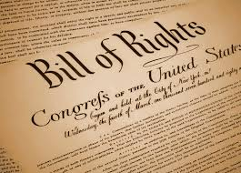
Bill of Rights

Slide 2
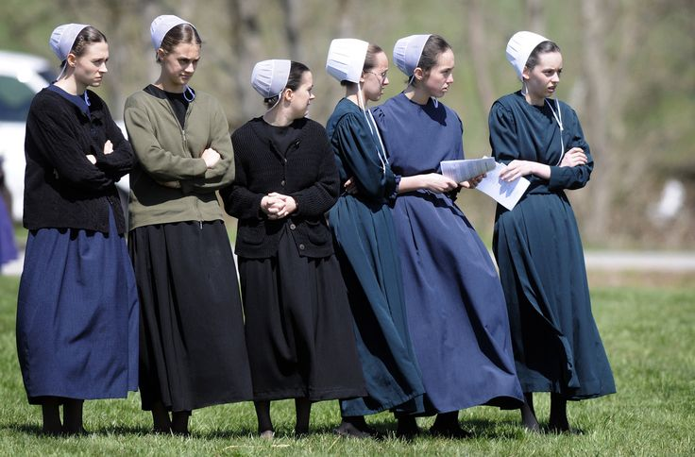
1st Amendment: RAPPS
5 Parts:
Freedom of Religion
Free Exercise clause: you can practice your religion
Establishment clause: the government can’t favor any religion over another

Slide 3
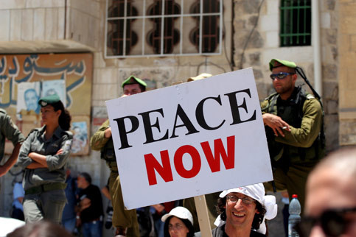
1st Amendment (cont.)
Freedom of Assembly (gathering as a group)
Freedom of the Press (reporting news)
Freedom to Petition the Government (protesting)
Freedom of Speech
Does not include
libel or slander
(harmful and untrue writing or speech about a person) libel is writing, slander is spoken

Slide 4
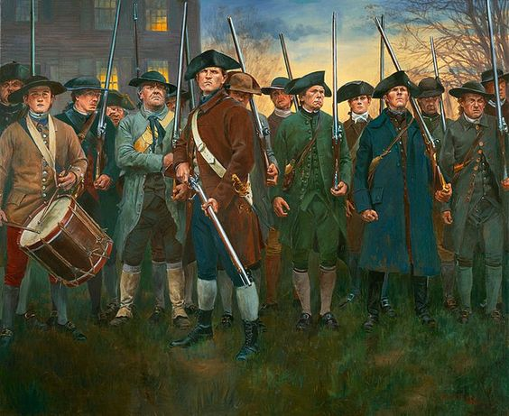
2nd Amendment
The right to bear arms
Form a well-regulated militia

Slide 5
3rd Amendment
No quartering soldiers
The government can’t require you to let soldiers stay at your house
In the Revolutionary War, the British forced the people of Boston to quarter soldiers

Slide 6
4th Amendment
No unreasonable search and seizure
Cops need a warrant or probable cause to search you or your property

Slide 7
5th Amendment
Grand Jury – the court needs enough evidence to charge you with a crime
No double jeopardy – if you’re found innocent, they can’t put you on trial again
Eminent Domain – government must pay you if they take your land
Due process – guaranteed a fair trial
No self-incrimination (“I plead the 5th”)

Slide 8
6th Amendment
Speedy and public trial
Impartial jury
Habeus Corpus – have to tell you why you were arrested
Right to a lawyer
Right to confront witnesses

Slide 9
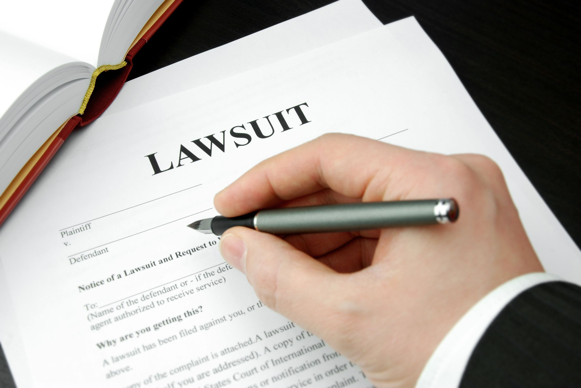
7th Amendment
Right to a jury in civil suits (one person or group sues another)

Slide 10
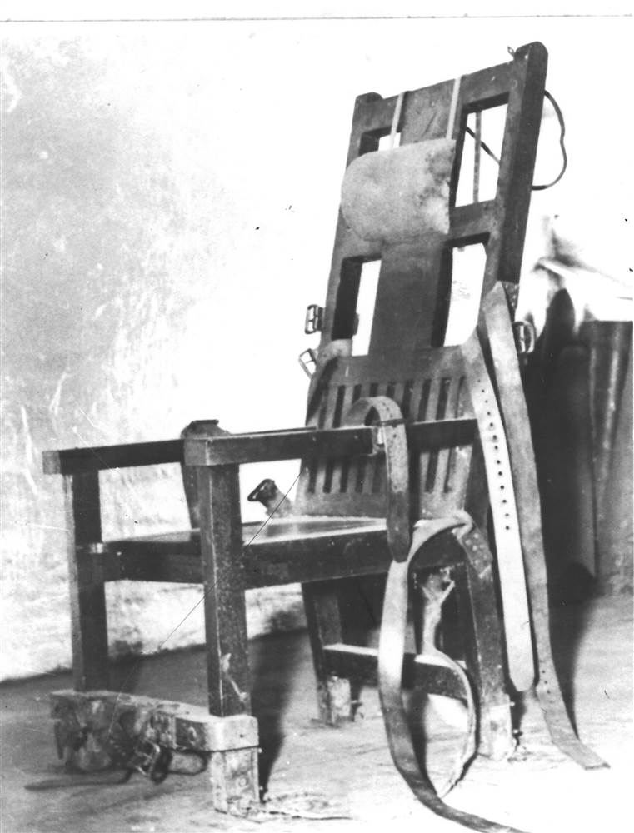
8th Amendment
No cruel or unusual punishment

Slide 11
9th Amendment
All rights not listed in the Constitution are still protected
Ex: the Constitution doesn’t say you can go on vacation but you definitely still can

Slide 12
10th Amendment
All powers not given to the national government are reserved for the states
These are called Reserved Powers

