Slide 1
Inflation & the stock market
Price stability

Slide 2
Price stability
Inflation is another indicator of how the economy is doing. It is an increase in the general price of goods and services. Inflation decreases the purchasing power of currency.
Ex: If there has been inflation since last year, you will be able to buy fewer groceries with $20 than you could last year.
Consumer Price Index (CPI) – a tool that keeps track of the prices of about 400 goods and services. The CPI measures the average change in these prices over time. If prices have generally increased, inflation is present.

Slide 3
Who does inflation hurt?
Since inflation causes money to lose purchasing power, the same amount of money will be able to purchase less and less over time.
This harms people who have fixed incomes, meaning they receive the same amount of money every year. This includes people who are living off pensions or social security.
Savings accounts typically have very low interest rates, which often aren’t enough to keep up with inflation. If inflation increases drastically, your savings could seriously decrease in value.
So what can you do to make sure your money grows with the economy?

Slide 4
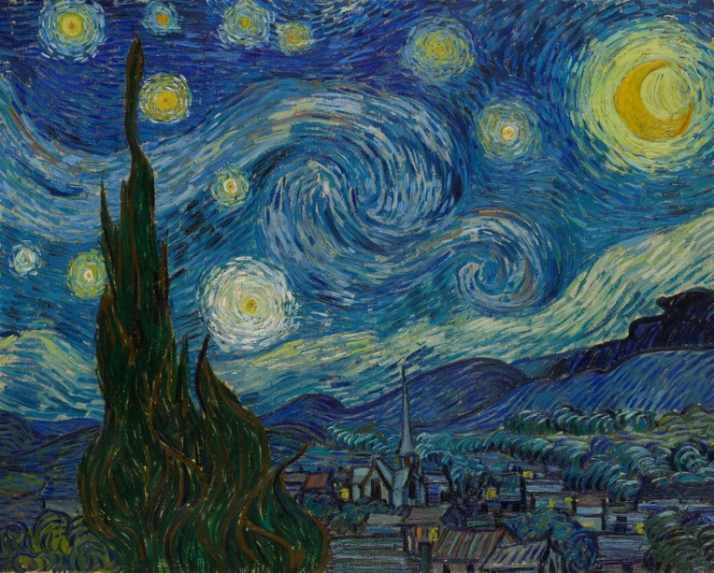
speculation
Sometimes, people will use speculation to increase the value of their money over time. They purchase items that they believe will go up in value over time, like gold or artwork.
A lot of people did this with Beanie Babies in the 90s! Didn’t turn out so well.

Slide 5
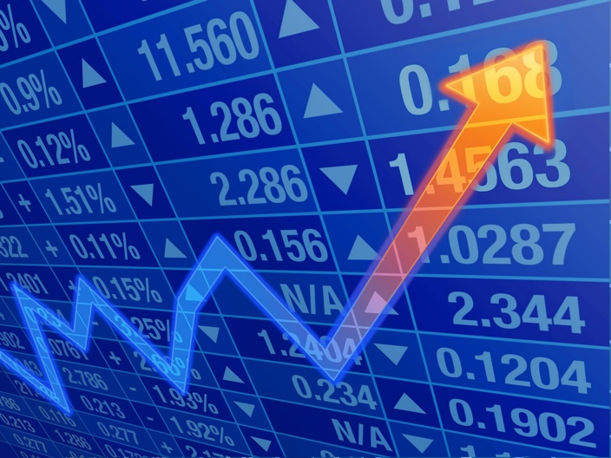
The stock market
Last unit, we talked about how corporations sell shares of ownership, also called stocks, to gain capital.
If you believe a business is going to grow and earn more money in the future, you may decide to buy stock from that company.
Two ways to make money from stock:
Dividends are a share of the corporation’s profits that are distributed to shareholders.
Capital gains – when you sell stock for more than you spent on it.

Slide 6
How do you know if the stock market is doing well?
Stock Market Indexes are tools that track the prices of certain stocks over time to measure if the stock market is increasing or decreasing.
Dow-Jones Industrial Average (DJIA) – tracks the stock prices of 30 corporations from various industries to measure the state of the economy as a whole.
Standard and Poor’s (S&P 500) – tracks the stock prices of 500 major corporations.

Slide 7
Stock exchanges
Stocks are bought and sold at stock exchanges like the New York Stock Exchange or through an electronic stock exchange like NASDAQ.
Most people hire a stock broker, a person who specializes in completing stock purchases and will conduct the actual transaction for you.
Fun Fact: When stock prices are expected to rise, it’s called a bull market.
When stocks are expected to fall, it’s called a bear market.
When a bear attacks, it raises its paw and swipes downward. When a bull attacks, it’s head is low and then it thrusts its horns upward.

