Slide 1
Government Regulations
In-Depth Review (and some new stuff!)

Slide 2
Private vs. Public Goods
Most goods produced by businesses are private goods. This means you can’t consume/enjoy the good unless you pay for it. These goods are said to be exclusionary because if you can’t pay for it, you are excluded.
Ex: An iPhone, a car, or a haircut
A public good is one that many people can enjoy without depleting it. These goods are non-exclusionary because everyone gets to use them.
Ex. Public schools, libraries, parks, and highways.
What do these public goods have in common?
They’re made by the government!

Slide 3
Public Goods
Public goods are paid for mostly by tax revenue.
The government has to provide these goods because there is very little profit to be made even though many are seen as necessities. In most cases, the private sector would be unwilling to produce these goods and services.

Slide 4
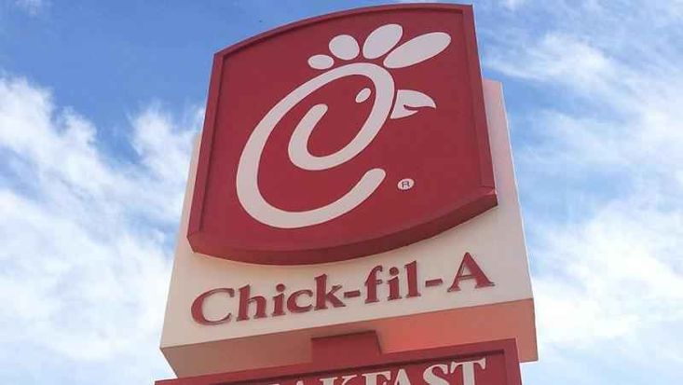
Externalities (We need to review this in-depth!)
Externality: An unintended side-effect of an action that affects someone else who was not involved.
Ex: If your parents give you money for your birthday, an externality of that would be that Chick-fil-a receives a lot more business that week!
This is a positive externality!
An externality of a factory increasing production could be that Lake Norman becomes more polluted.
This is a negative externality.

Slide 5
Externalities (continued)
The government sometimes creates regulations to lessen the effects of negative externalities. This is why the Executive Branch has so many regulatory agencies!

Slide 6
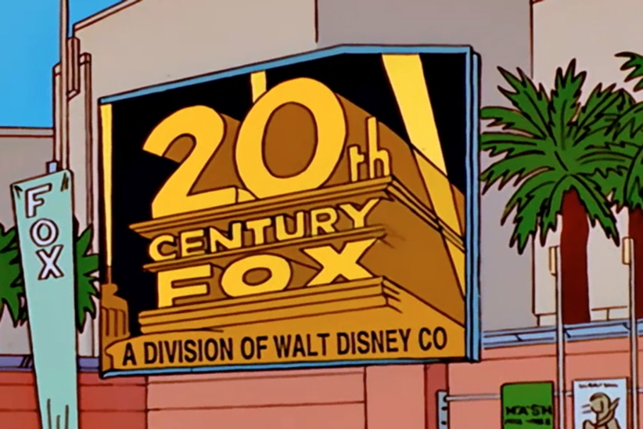
Maintaining Competition
Tell me about monopolies!
The government wants to make sure we have plenty of competition in our economy to encourage companies to keep prices low and create better products.
Sherman Antitrust Act (1890) The government banned monopolies because they prevent competition.
Broke up Standard Oil in 1911!
The Clayton Act (1914) broadened that law to allow the government to approve or deny certain mergers, or companies trying to combine into one. It also gave rights to labor unions!
Ex: Staples and OfficeMax were not allowed to merge.

Slide 7
Natural Monopolies
Sometimes, certain industries have such high start-up costs that it makes financial sense to let one company have a monopoly. Having multiple companies in one area would be inefficient.
Ex: Duke Energy!
In exchange for letting these companies have a monopoly, they agree to submit to intense government regulation. For Duke Energy, the NC General Assembly has to approve rate increases.

Slide 8
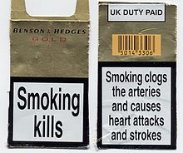
Regulating Products
The government can also control how companies advertise their products and what they can put on the label. This is to prevent false/misleading advertising.
Ex: What can be labeled as “organic”, allergy warnings, and disclaimers.
The government can also make companies issue a recall for a product found to be unsafe. You can return unsafe items for a full refund, repairs, or replacement.
Ex: Eggs and Romaine lettuce!!!
Also car parts.

Slide 9
Assignment!
With a group of 2-4 people, brainstorm an idea for a business you would like to start. Create a poster with the following sections:
What is your business? Provide a brief description and create a logo.
What are some externalities (3 positive and 3 negative) your business may create for the surrounding community?
Remember: an externality has to affect people whether they buy your goods or not!
What government regulations might your business have to follow? (at least 3)
NO ILLEGAL BUSINESSES!!!!! I MEAN IT!!!!!

